Slide 1

Acme corporation

Slide 2

AGENDA
Work life balance
Job Involvement
Relationship Satisfaction
Over time
Takeaways

Slide 3

Average of job involvement v/s job role
Compared to other roles Research scientist has an average of 11.67% more job involvement than the other roles and the least Job Involvement is by the sales executives has an average of 10.85% and sales representatives has an average of 10.88%.
The feature shows how much of job involvement each job role contributed for each category.
It gives a clear picture of each job role being analyzed and easy to understand the work insights.

Slide 4

Total work life balance over time
In the graph, it clearly shows that 807 employees get over time and 306 employees doesn’t get over time. This shows an imbalance of work share and causes stress among the employees.
Hence the work must be distributed among the employees in an equal manner.

Slide 5

Average work life balance v/s job role
This comparison between average work life balance and job role, shows that HR has 2.92 maximum work life balance compared to the other job roles
Sales representative has 2.89 work life balance compared to other job roles.
The least average work life balance is of Research Scientist is 2.68
Conclusion: The maximum job involvement is done by Research Scientist, so they have less work life balance, in this scenario HR has less job involvement so they have more work life balance.

Slide 6

Count of job involvement by department
In this scenario, Each department showcases how much they contribute
Research & development has 961 employees.
Sales has 446 employees.
Human resources has 63 employees.
Conclusion: since HR has low manpower count, their job involvement is comparatively less than other departments.

Slide 7
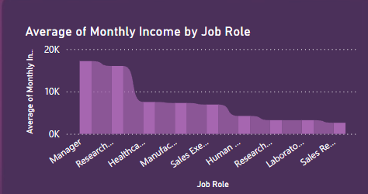
Average monthly income by job role
Managers and Research Scientists have the highest average monthly income compared to the other job roles
The monthly income differs according to the job role
Sales representative gets the least average monthly income compared to the other job roles.
The job role is a crucial for every employees

Slide 8
Average work life balance by department
Characteristics of work-life balance are:
Time Allocation
Flexibility
Integration
Well-being
Human Resource has the best work life balance of an average of 2.92 compared to the other departments.
Sales has an average of 2.82 work life balance.
Resource & Development has an average of 2.73 work life balance among the other departments.

Slide 9

Average job satisfaction balance by Attrition
In this comparison it is concluded that the attrition rate is almost the same for job satisfaction.
Job satisfaction is an important factor for work life balance for the employees

Slide 10
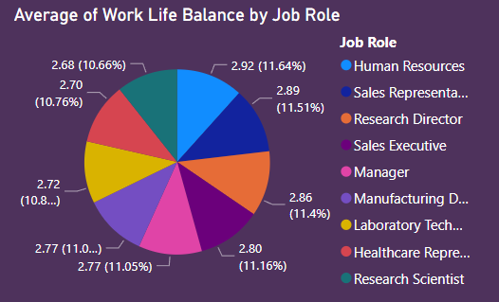
Average work life balance by job role
In this pie chart , its clearly seen that HR has highest work life balance compared to the other job roles.
The Research Scientist has the least work life balance.
Conclusion: In this scenario, since the Research Scientist has more job involvement, that’s why they has less work life balance.

Slide 11
Average of working years, % Salary hike and attrition by training times last year
While comparing this data, it shows that attrition rate is very low.
There isn’t much of a difference for the average of salary hike, training times and working years at the company
For enhancing work life balance
Team- Building should be motivated
Focus on physical and mental health
Fun clubs
Unpaid time off for personal reasons

Slide 12
TAKEAWAYS
Job involvement of Research Scientist is more compared to other job roles
Many employees doesn’t have over time, and this brings in stress among the employees. So, it should be equally distributed among the employees.
The work life balance is high for HR compared to the other departments.
R&D has the most manpower count for job involvement within departments.
Managers and Research scientists have the highest average income compared to the other job roles.
There is more job involvement that has less over time and less job involvement in more over time. So, its because of stress the employees are not able to perform well. Hence the over time must be equally distributed among the employees

Slide 13

THANK YOU
Divya Haridas
Technocolabs Softwares
Internship Project

